Slide 1
Review of Software Engineering
BIT 2203: Advanced Programming

Slide 2
Outline
1. Overview / definition of terms
2. Lifecycle models
3. Requirements capture, analysis and specification
4. Software design
5. Software quality
6. Software testing
7. Some recent developments

Slide 3
What is software engineering?(1)
The establishment and use of sound engineering principles (methods) in order to obtain economical software that is reliable and works on real machines
F.L. Bauer. Software Engineering. Information Processing 71., 1972

Slide 4
What is software engineering?(2)
Software engineering is the technological and managerial discipline concerned with systematic production and maintenance of software products that are developed and modified on time and within cost estimates
R. Fairley. Software Engineering Concepts. McGraw-Hill (New York), 1985.

Slide 5
What is software engineering?(3)
Software engineering. (1) The application of a systematic, disciplined, quantifiable approach to the development, operation, and maintenance of software; that is, the application of engineering to software. (2) The study of approaches as in (1)
IEEE Std 610-1990

Slide 6
What is not software engineering?
Computer science
concerned with theory and fundamentals
software engineering concerned with practicalities of developing and delivering useful software.
still insufficient to act as a complete underpinning for software engineering (unlike e.g. physics and electrical engineering).
Software Engineering, Sommerville

Slide 7
What is not software engineering?(2)
System engineering
concerned with all aspects of computer-based systems development including hardware, software and process engineering
software engineering is the part of this process concerned with developing the software infrastructure, control, applications and databases in the system.
system engineers involved in system specification, architectural design, integration and deployment.
Software Engineering, Sommerville

Slide 8
Why Software Engineering?
Term “software engineering” popularised in the late 1960s
Response to the so-called “software crisis”
hardware performance was increasing much faster than software performance.
large software system development was unsatisfactory; major projects:
were usually delivered late (sometimes very late)
usually went over-budget (sometimes massively overbudget)
gave rise to unreliable products that were difficult to maintain

Slide 9
Why Software Engineering?(2)
Techniques used for “single-developer” software do not scale up.
large projects require a team
quality of communication between members a serious problem → documentation
Desire to benefit from previous experience
Need to plan for maintenance and evolution
important design decisions must be documented

Slide 10
Why Software Engineering?(3)
Communication with the client/user is of paramount importance
understand the client requirements
e.g. Xtreme programming: client represented on development team

Slide 11
Why Software Engineering?(4)
Need to estimate how much effort, time and money needed
based mainly on modelling of current project & comparison to previous projects
do we want the job? how much to charge?
c.f. Constructive Cost Model COCOMO
Constructive Systems Engineering Cost Model COSYSMO
c.f. The mythical man month, Brooks, 1975: adding manpower to a late software project makes it later

Slide 12
What is a software development process?
Process:
A series of actions or operations conducing to an end (Websters)
Software development process
The set of activities, methods and practices used in the production and evolution of software.

Slide 13
What is a software development process?
A software development process can include
a lifecycle model
dividing the development into phases and prescribing the activities to be carried out in each phase
providing criteria to determine when each development phase has terminated
defining the deliverables / artifacts / products of each phase
consideration of tools and equipment
consideration of personnel and their organisation
constraints on activities, artifacts, tools, personnel, etc.
For many authors:
Software Development Process = Software Life-Cycle

Slide 14
What is a software lifecycle?
The period of time that starts when a software is conceived and ends when the product is no longer available for use.
The software life-cycle typically includes a requirements phase, design phase, implementation phase, test phase, installation and check-out phase, operation and maintenance phase, and sometimes, retirement phase.
A Software Lifecycle Model is a particular abstraction that represents a Software Life Cycle. A Software Life Cycle model is often called a Software Development Life Cycle (SDLC).
IEEE Standard Glossary of Soft. Eng. Terminology

Slide 15
Software (& Hardware) Modelling
Sceptic’s view of Software Models:
“bubbles and arrows, as opposed to programs, never crash” Bertrand Meyer 1997
The use of models is as old as engineering
before building the real thing, engineers build models and learn from them
Some desirable characteristics of a model
abstract
understandable
accurate
predictive
inexpensive to build

Slide 16
Modelling: The Purpose of Models
To help us understand a complex problem by analysis and simulation
To enable the investigation and comparison of alternative solutions
To facilitate the communication of ideas about a problem or a solution
To enable the detection of errors and omissions during the design
To drive the implementation
software peculiarity: the model becomes the implementation

Slide 17
Lifecycle models
Waterfall life cycle model
V life cycle model
Incremental
Evolutionary life cycle modell life cycle model
Spiral life cycle model

Slide 18
Requirements capture, analysis and specification
Requirements Engineering
Systematic use of well-established principles, techniques, languages and tools to obtain the cost effective analysis and documentation of continually evolving user needs and the specification of the external behaviour of a system that satisfies these needs.
Donald Reifer (see Pressman)

Slide 19
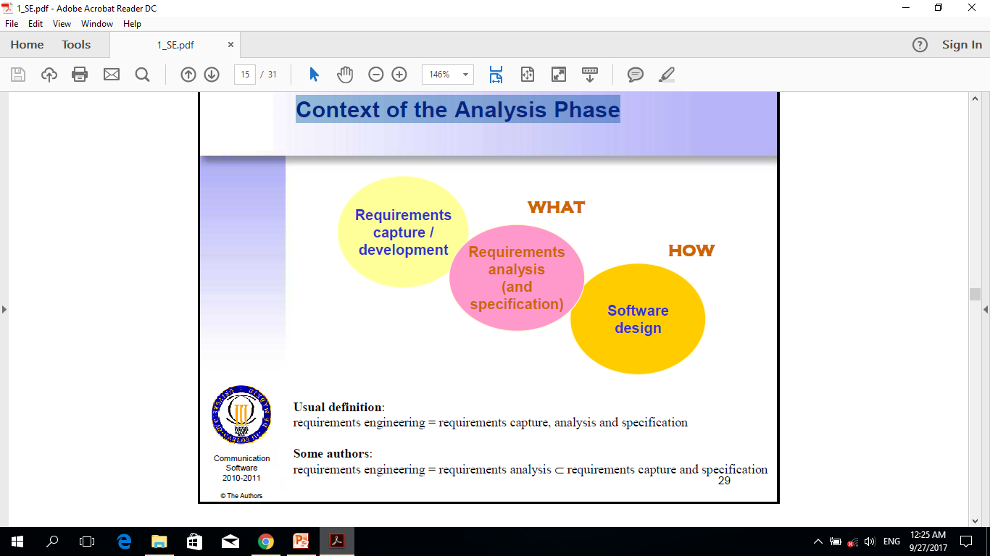
Context of the Analysis Phase

Slide 20
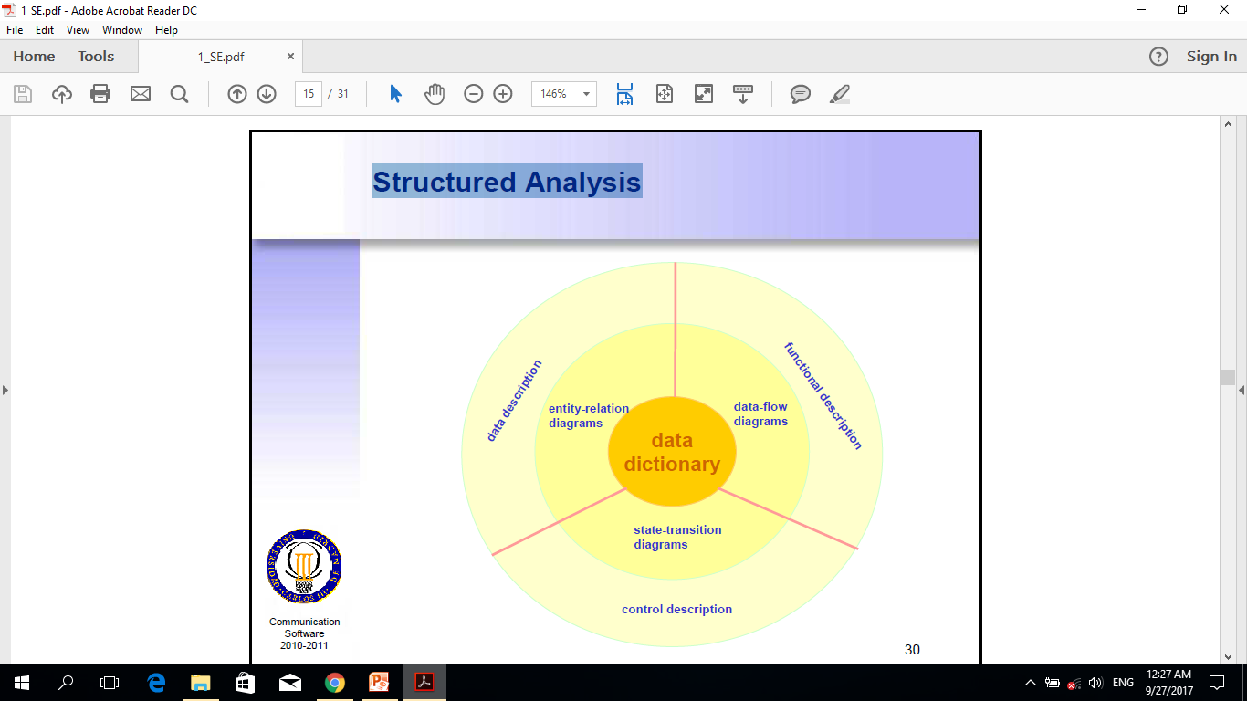
Structured Analysis

Slide 21
OO Analysis
Based on objects and their operations/attributes instead of on data flows
Currently most commonly-used notation: UML
structural models (class model, component model,…)
behavioural models (use-cases, state model, collaborations, interactions,…)
Structural models
via domain analysis
Behavioural models
use-case modelling is favoured technique
other behavioural models can be problematic
refinement of analysis model to design model?

Slide 22
Software Design: Brief History
Late 1960s: control oriented design (Structured Programming)
modularity
single-entry, single-exit program constructs (sequence, selection, iteration)
no use of “go to” construct (but what about exception handling?) : “Goto Statement Considered Harmful”, Dijkstra, Comm. ACM, 1969

Slide 23
Software Design: Brief History
1970s: data-structure oriented design (extension of Structured Programming)
program code structure reflects data structure e.g. Jackson Structured Programming
1980s: object-oriented design
unifies data-structure oriented and control oriented design (or does it?)
currently most commonly-used notation: UML

Slide 24
What is software architecture?
The fundamental organization of a system, embodied in its components, their relationships to each other and the environment, and the principles governing its design and evolution.
ANSI/IEEE Std 1471-2000, Recommended Practice for Architectural Description of Software-Intensive Systems

Slide 25
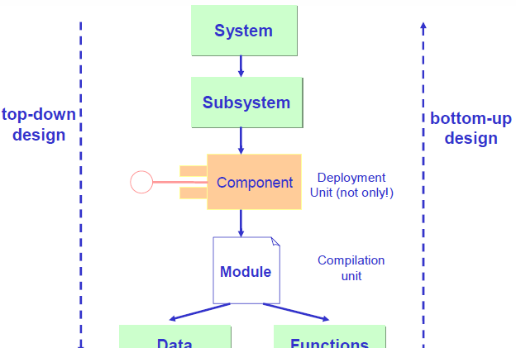
Software Architectures

Slide 26
Software Architecture Essentials
Components and subsystems
what are the individual elements
Connections
how components communicate
Topology
how components and connections are organised
Constraints
restrictions on components, connections, topology, evolution,…

Slide 27
Software Architectural Styles
Restrict the way in which components can be connected
Promote fundamental principles
separation of concerns, generality, incrementality, low coupling, high cohesion,…
Based on success stories
also chosen on the basis of application type
Examples:
pipe-and-filter, layers, software bus, client-server, peer-to-peer, hierarchical, centralised control, 3-tier client-server, etc.

Slide 28
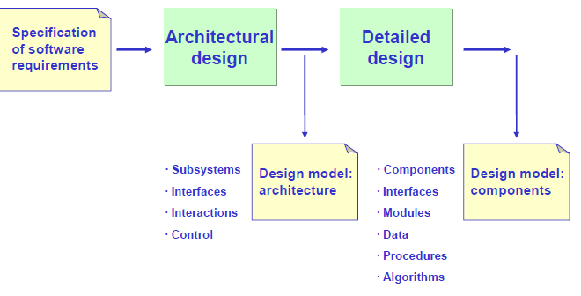
Typical Design Process

Slide 29
Some Basic Design Concepts
Abstraction
emphasis on important details, omitting characteristics that are not relevant in the context
Refinement
the process of gradually adding more detail, going from more abstract models to more concrete models
Modularity
decomposition into components that are to be integrated to satisfy the problem requirements
Information hiding
ensuring components only make available such information as is needed by other components (interfaces do not show design/implementation details)

Slide 30
Some Design Quality Factors(1)
External criteria (user point of view)
Correctness
Reliability
Usability / user-friendliness
Good performance
Robustness
Internal criteria (developer point of view)
Efficiency
Maintainability
Reusability
Portability
Interoperability

Slide 31
Some Design Quality Factors(2)
From the maintenance and reuse perspective
Functional independence of components
High intra-component cohesion
Low inter-component coupling
Readability / understandability
Naming scheme
Complete and up-to-date documentation
Simplicity / Elegance
Adaptability
Evolvability and generality
Automation of access to documentation
Automation of version control

Slide 32
SQA: Software Quality Assurance(1)
Involves activities performed throughout the software life cycle
Definition of verification (after IEEE):
ensure a software system, or a model of it, meets a specification (often produced in a previous development phase)
concerned with internal consistency
“are we building the system right?”
Definition of validation (after IEEE):
ensure a software system, or a model of it, meets the requirements (customer’s intent)
concerned with external consistency
“are we building the right system?”
Software Testing
usually considered validation but can also be verification
Software Metrics

Slide 33
What Are Formal Methods?
Formal semantics: semantics based on set theory, algebra, logic, automata, graph theory, etc.
Formal specification: an abstract description with a formal semantics; specification styles:
model-oriented
property-oriented
Formal method: a method used in software/hardware development involving use and manipulation of formal specifications:
proving properties on formal specifications
deriving implementations, or other software artifacts (e.g. test cases), from formal specifications
proving properties on implementations by using an abstract interpretation of the code

Slide 34
Use of Formal Methods
Especially important for safety-critical systems, e.g.:
– aircraft, trains, metro
– power grid, power stations
– telecom networks
Also for secure systems
May also be worthwhile for low-cost but massively produced systems
Often introduced after serious problem occurs, e.g.:
model-checking at Intel after Pentium floating point division error discovered

Slide 35
What is software testing?
The execution of the software implementation in a controlled fashion using carefully chosen input data and the observation of the result.
Software testing is one aspect of Software Quality Assurance (SQA)

Slide 36
Definition of a test case
A specification of an interaction
between the Implementation Under Test (IUT) and the test software, or human user (playing the role of the IUT environment),
in which the latter stimulates the IUT via its interfaces, observes its behaviour and its responses
and, if it includes a test oracle, assigns a verdict to the result of this interaction.
A test case is designed to exercise a particular execution or verify compliance with a specific requirement.

Slide 37
Basic Software Testing Notions
The goal of testing is to find errors NOT to prove their absence
a successful test finds an error
no amount of testing can guarantee an error-free program
Should test that the application
does what it is supposed to do
does not do what it is not supposed to (as far as possible).
Testing approaches (sometimes term “grey box” is also used)
black box testing
white box testing (structural testing)
Testing phases
unit testing
integration testing
system testing

Slide 38
Basic Software Testing Notions(2)
Test coverage
white box: segments, branches, conditions, loops,…
black box: requirements
Test data selection (mainly for black box)
equivalence partition (uniformity hypothesis)
boundary value analysis
• Other types of testing
acceptance testing
performance testing
robustness testing
stress testing
interoperability testing
regression testing
mutation testing

Slide 39
Some Recent Developments
Design patterns
general, repeatable solution to a commonly-occurring problem in software design
inspiration in architecture
insufficient theoretical foundation?
Software frameworks:
a reusable design for a software system or subsystem (architectural pattern?)
Software product lines
software development process for a set of related products
generally use software frameworks

Slide 40
Some Recent Developments(2)
Lightweight development (in response to software & documentation “bloat”):
extreme programming, Scrum, etc.
agile modelling
Model driven development
primary artifacts are models rather than programs (⇒ code generation)
OMG’s MDA initiative (PIMs and PSMs)
design refactoring
Service-oriented architecture (SOA)
architectural style whose goal is to achieve loose coupling among interacting software agents playing producer or consumer roles

Slide 41
Some Recent Developments(3)
Component Based Software Engineering
system assembled (at least partially) from existing components.
Open Source Software Engineering
collaboration between often large numbers of spatially separated developers
novel management and organisational structure
heterogeneity in use of tools, approaches etc.
study of relation to traditional S.E. on-going
Web Engineering (development of Web applications)
currently very popular types of applications
are there particular development characteristics or is it just “hype”?

